Slide 1

Common Law Marriage: A Guide to CURRENT MCA LEGISLATION AND cohabitation reforms
Tina Harrington, Trinity Chambers
Anne-Marie Lucey, Trinity Chambers

Slide 2
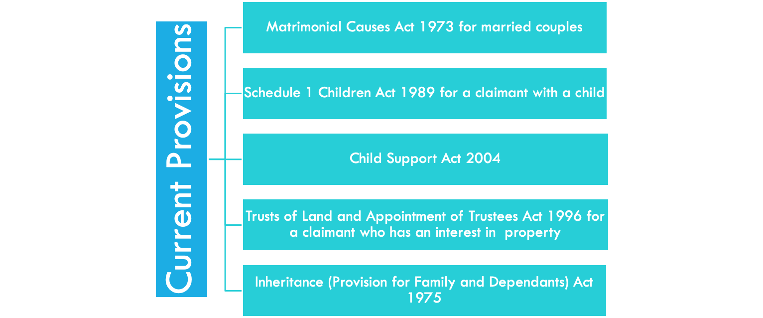
Background: What are the current provisions for those separating?

Slide 3
Why are the provisions for cohabitating couples being discussed?
Labour’s Manifesto outlined their clear commitment to achieve better protection for cohabitating couples, with a focus on improving rights for women.
Around 3.5 million couples cohabit, which has doubled in the last thirty years. However, the legal provisions regarding separation have not adapted. Cohabiting couples and their children have very limited financial protections should a relationship end.
Common law marriage does not exist, there is limited protection.

Slide 4
What are the proposals?
Couples who have lived together for three years or have a child of the family will be able to bring a claim within two years of separation. It shall be determined on a needs based approach.
Couples who have cohabited for five years will be afforded protection with automatic inheritance provisions.
Possibility to opt out of the provisions, but requires consent from both.

Slide 5
What is proposed?
Step two:
Live together for three years, or
Step three:
Have a child together
Step four:
Automatically part of proposed legal framework
Step five:
If relationship ends, either can ask the Court to make financial orders
Step one:
Move in together
Possibility to opt out from legal provisions, if both agree. Requirement to have agreement in the form of a deed after there has been financial disclosure and independent legal advice.

Slide 6
Proposed ambit for financial claims
Pension sharing orders
Property adjustment orders
Lump sum payments
Maintenance (only in limited circumstances)

Slide 7

PROPOSALS TO THE EXISTiNG MCA PRINCIPLES
Clarity around the definition of needs
Meaning of matrimonial property
Meaning of non-matrimonial property
Matrimonialisation?
Enforcement of nuptial agreements
Re-enforcing the conduct case law
Introducing legislation providing for the status of nuptial agreements?
White papers x2
Green paper
Radmacher?

Slide 8
WHAT IS PROPOSED REGARDING INTESTACY?
Eligible cohabiting couples would have the same intestacy rules in the same way as a spouse.
If there are no children involved, they would receive the whole estate.
If there are children involved, the surviving partner would receive all personal possessions, the first £322,000 and half of the rest of the estate. The remainder would go to the children.

Slide 9
What has the response been?
What is the impact on those who intentionally cohabit to avoid financial claims?
How will it interact with existing provisions?
Need to define qualifying relationships carefully.
What is the definition of needs?

Slide 10



How do other commonwealth countries protect cohabiting couples?
Australia
Scotland

Slide 11
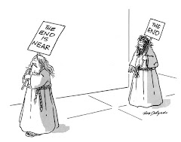
Is this the end of the matrimonial causes act 1973?

Slide 12
Any questions?
Tina Harrington, Trinity Chambers
THarrington@trinitychambers.com
Anne-Marie Lucey, Trinity Chambers
AMLucey@trinitychambers.com
Clerks@trinitychambers.com

